Slide 1

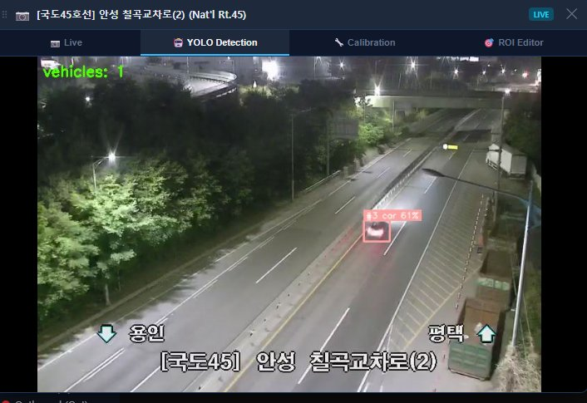
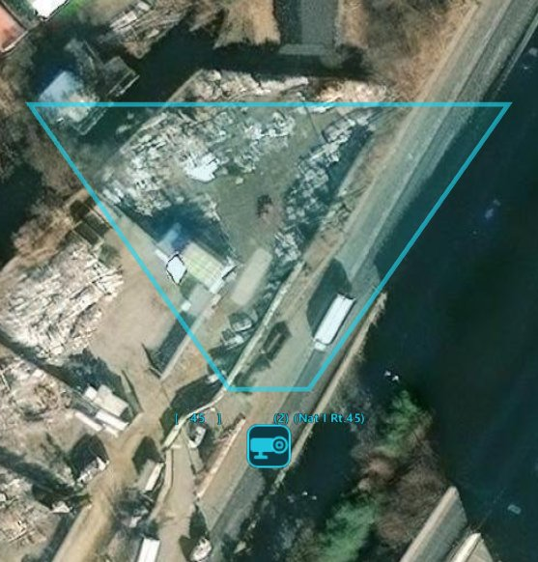
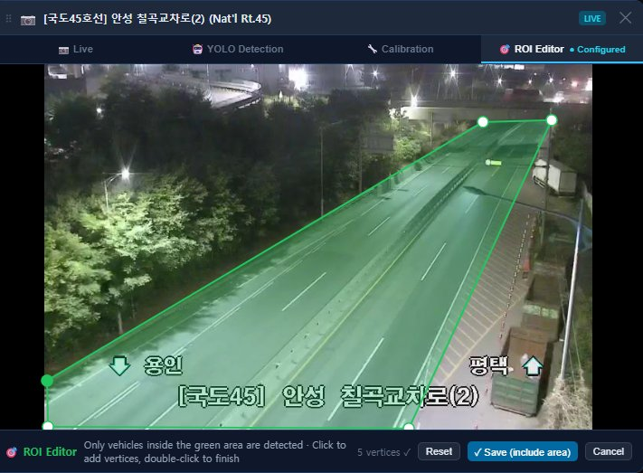
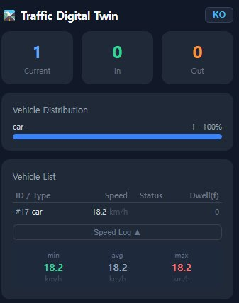
Digital Twin
Minsoo Ahn | CSE 327 | Real-time Vehicle Detection & Traffic Analytics from Live CCTV Streams
INTRODUCTION
Demo
SETTING
Logic & Arch
Result & Limitation
Reference

